Slide 1


The World Of Herbology

Slide 2

Presented by:
HETVI GALA | 2019205
MANSI MAKWANA | 2019208
VAIBHAVI OZA | 2019210
AKSHAY BAROT | 2019218

Slide 3
INTRODUCTION
Patanjali Ayurved Kendra Ltd was founded by Swami Ramdev and Acharya Balakrishna on September 27th, 2007. It started its operation in Katmandu, Nepal to provide holistic, natural and effective ayurvedic treatment.
“Patanjali“ is represented by Guru Swami and the company is set up with a motive to provide high quality Indian products at fair price which are organic and natural.

Slide 4
RESEARCH METHODOLOGY & SAMPLING TECHNIQUE
For collecting Primary data, a survey approach was used only for Mumbai city.
A Pilot survey of sample size 50 personally & made the necessary changes.
The data was also encoded according to the techniques used.
Convenient sampling was used as the sampling method.
N=501
388
Patanjali users
113
Non-Patanjali users
44
Other Herbal brands users
69
Non-herbal brand users

Slide 5
SWOT ANALYSIS
SWOT
Strength
Advantages of a organization
Weakness
Areas of improvement
Opportunities
Factors that may contribute to organization and can build up strength
Threats
Potential problems/ risk caused
OBJECTIVE 1
To study the internal and external environments of a company, through the identification and analysis of the strengths and weaknesses of the organization, and the opportunities and threats to which it is exposed.
SWOT Analysis is a simple but useful framework for analyzing your organization's strengths, weaknesses, opportunities, and threats.

Slide 6
Strength
Baba Ramdev
Strong Patriotism
Weakness
Over dependency on Ramdev
Lack of experienced management graduates
Opportun-ities
Threats
Growing Organic sector
Rural Expansion
Going global
Tie-ups
Comparatively Low Prices
Ayurveda & Herbal
Price war
Increasing Competition
Poor reap
Negative word of mouth
Penetration pricing is not long term
Product Dependence
Low number of manufacturing units
Diversification

Slide 7
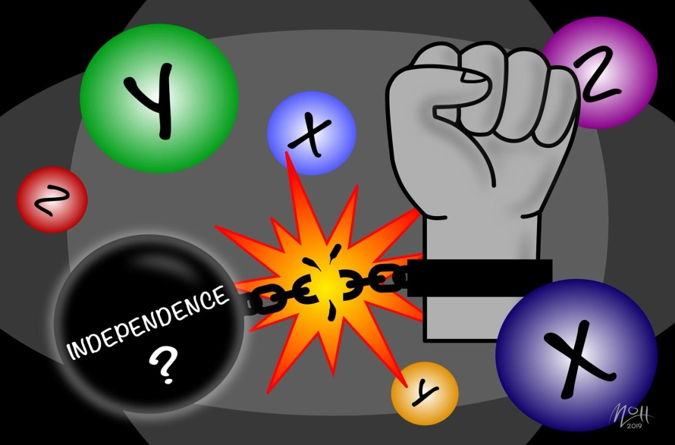
CHI SQUARE TEST OF INDEPENDENCE
OBJECTIVE 2
To test the association between gender and their health-conscious behaviour towards the Patanjali products.
Chi Square test of independence measures whether there is a relationship between two categorical variables.
The Chi Square statistic is a non-parametric tool designed to analyze group differences when the dependent variable is measured at nominal level.
Variables Considered
Health Conscious Factors
Gender
Side Effects
Doctor's Recommendation

Slide 8
SUB-OBJECTIVE FOR FURTHER ANALYSIS
To test the association between gender and their consideration over doctor's recommendation while buying the Patanjali products.
To test the association between gender and their experience over any side effects while using the Patanjali products.
HYPOTHESIS
HO1: There is no significant association between the gender and their consideration over doctor's recommendation.
H11: Not HO1
HO2: There is no significant association gender and their experience over any side effects.
H12: Not HO2

Slide 9
CASE 1 Gender * Doctor’s recommendation Cross tabulation
 |  |  | Doctor’s recommendation |  | Total
 |  |  | Yes | No
Gender | MALE | Count | 90 | 99 | 189
 |  | Expected Count | 97.5 | 91.5 | 189.0
 |  | % within Gender | 47.6% | 52.4% | 100.0%
 | FEMALE | Count | 105 | 84 | 189
 |  | Expected Count | 97.5 | 91.5 | 189.0
 |  | % within Gender | 55.6% | 44.4% | 100.0%
Total |  | Count | 195 | 183 | 378
 |  | Expected Count | 195.0 | 183.0 | 378.0
 |  | % within Gender | 51.6% | 48.4% | 100.0%
Chi-Square Tests
 | Value | df | Asymp. Sig. (2-sided) | Exact Sig. (2-sided) | Exact Sig. (1-sided)
Pearson Chi-Square | 2.383ª | 1 | .123
Continuity Correction^{b} | 2.076 | 1 | .150
Likelihood Ratio | 2.386 | 1 | .122
Fisher's Exact Test |  |  |  | .150 | .075
Linear-by-Linear Association | 2.377 | 1 | .123
N of Valid Cases | 378
p-value(0.123)>0.05
Thus, we fail to reject H_{01.}
Hence, we conclude that there is no association between gender & doctor’s recommendation while buying the products, i.e., they are independent of each other.

Slide 10
CASE 2 Gender * side effects Cross tabulation
 |  |  | Side effects |  | Total
 |  |  | Yes | No
Gender | MALE | Count | 41 | 148 | 189
 |  | Expected Count | 42.5 | 146.5 | 189.0
 |  | % within Gender | 21.7% | 78.3% | 100.0%
 | FEMALE | Count | 44 | 145 | 189
 |  | Expected Count | 42.5 | 146.5 | 189.0
 |  | % within Gender | 23.3% | 76.7% | 100.0%
Total |  | Count | 85 | 293 | 378
 |  | Expected Count | 85.0 | 293.0 | 378.0
 |  | % within Gender | 22.5% | 77.5% | 100.0%
Chi-Square Tests
 | Value | df | Asymp. Sig. (2-sided) | Exact Sig. (2-sided) | Exact Sig. (1-sided)
Pearson Chi-Square | .137ª | 1 | .712
Continuity Correction^{b} | .061 | 1 | .805
Likelihood Ratio | .137 | 1 | .712
Fisher's Exact Test |  |  |  | .805 | .403
Linear-by-Linear Association | .136 | 1 | .712
N of Valid Cases | 378
p-value(0.712)>0.05
Thus, we fail to reject H_{02.}
Hence, we conclude that there is no association between gender & their experience over any side effects while using the products, i.e., they are independent of each other.

Slide 11
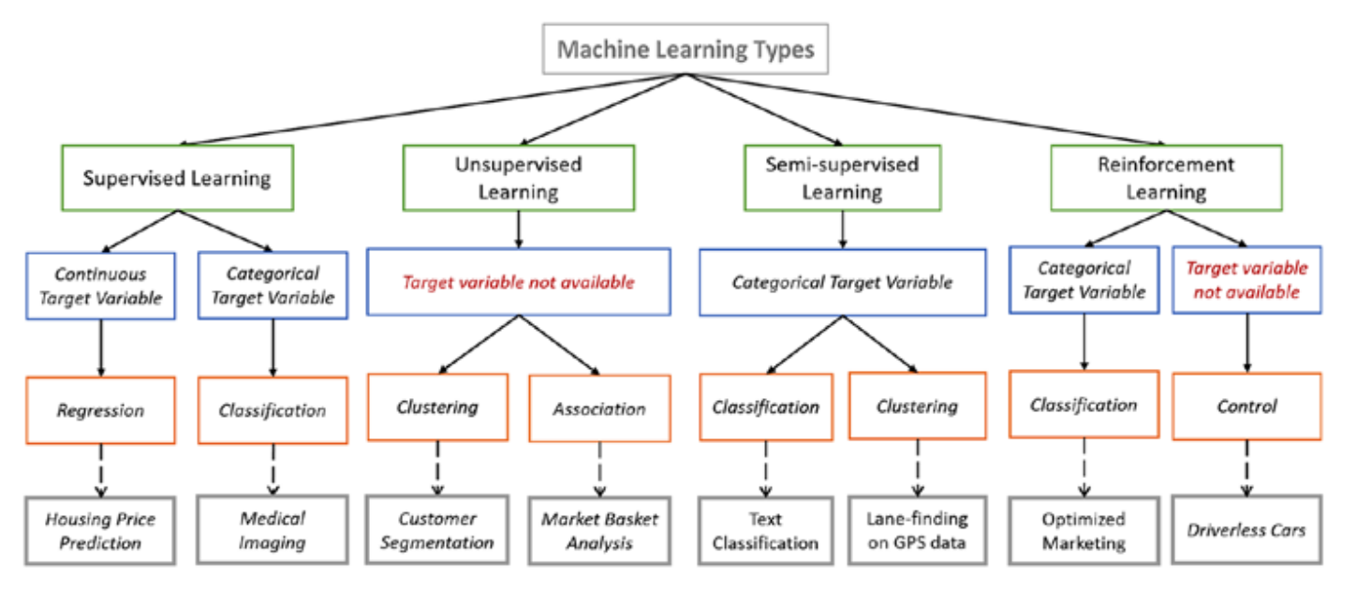

Slide 12
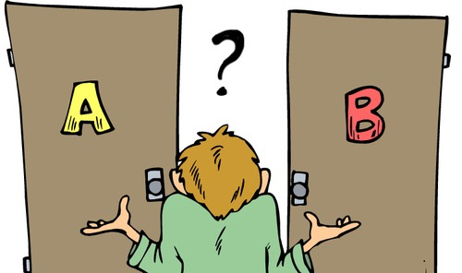

BINARY LOGISTIC REGRESSION
OBJECTIVE 3
To study the influence of various factors on overall satisfaction for the Patanjali users.
Logistic regression is an extension of simple linear regression, where the dependent variable is dichotomous or binary in nature.
Logistic regression is the statistical technique used to predict the relationship between predictors (our independent variables) and a predicted variable (the dependent variable) where the dependent variable is binary .

Slide 13
Take inputs
Encode the variables
Understand the variance explained
Category prediction
Get the variable in the equation
Wald’s test, odd’s ratio, Homser and Lemeshow
Fit the model
Target Variable
Independent Variables
Gender
Overall Satisfaction
Location
Monthly Expenditure
Years of use
Frequency of use
Consider over competitive brands
Complaints filed
Doctors recommendation
Side Effects
Popularity
Recommend to friends

Slide 14
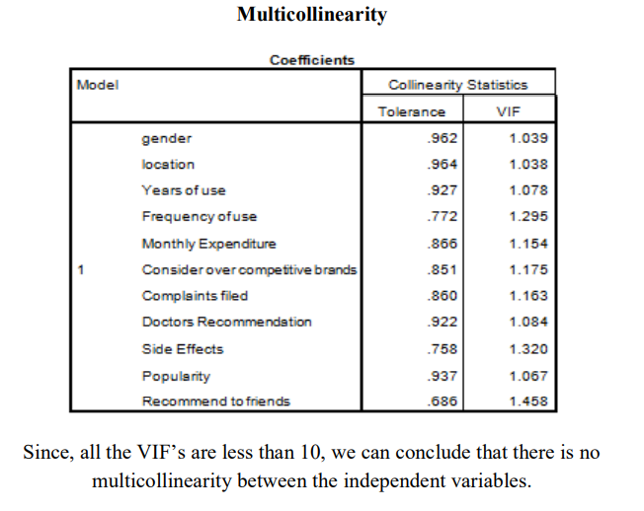

Slide 15
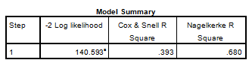
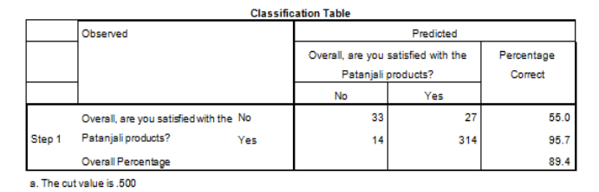
The explained variation in the dependent variable based on our model ranges from 39.3% to 68%.
Sensitivity= 95.7%
Specificity= 55.0%
Positive predicted value=100*(314/(314+27))=92.08%
Negative predicted value=100*(33/(33+14))=70.21%

Slide 16
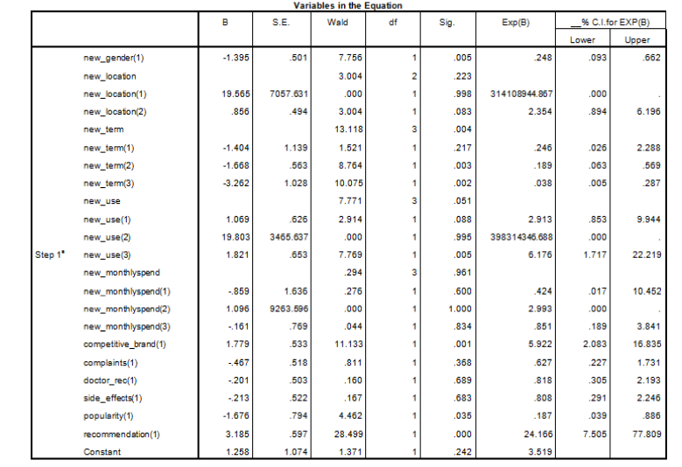
The statistical significance of the test is found in the "Sig." column. From these results, you can see that variables with p-value>0.05, did not add significantly to the model.

Slide 17
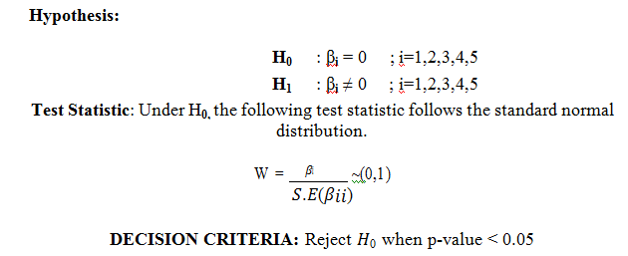
WALD’S TEST
Variable | p-value
Gender | 0.005
Location | 0.223
Years of use(new_term) | 0.004
Frequency of use(new_use) | 0.051
Monthly Expenditure | 0.951
Consider over Competitive brands | 0.001
Complaints filed | 0.368
Doctors recommendation | 0.689
Side Effects | 0.683
Popularity | 0.035
Recommend to a friend | 0
Hence, our influential variables are Gender, Years of use, Frequency of use, Consider over Competitive brands, Popularity and Recommendation to a friend.

Slide 18
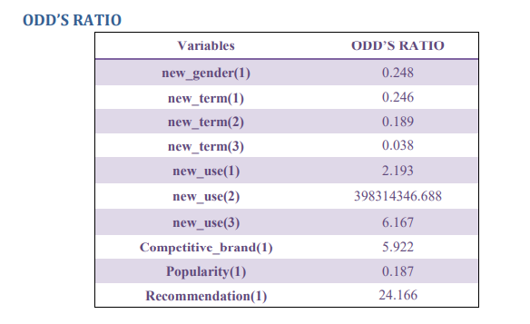
Variables | ODD’S RATIO
new_gender(1) | 0.248
new_term(1) | 0.246
new_term(2) | 0.189
new_term(3) | 0.038
new_use(1) | 2.193
new_use(2) | 398314346.688
new_use(3) | 6.167
Competitive_brand(1) | 5.922
Popularity(1) | 0.187
Recommendation(1) | 24.166
GENDER
YEARS OF USE
CONSIDER OVER COMPETITIVE BRANDS
POPULARITY
FREQUENCY OF USE
RECOMMEND TO FRIEND

Slide 19
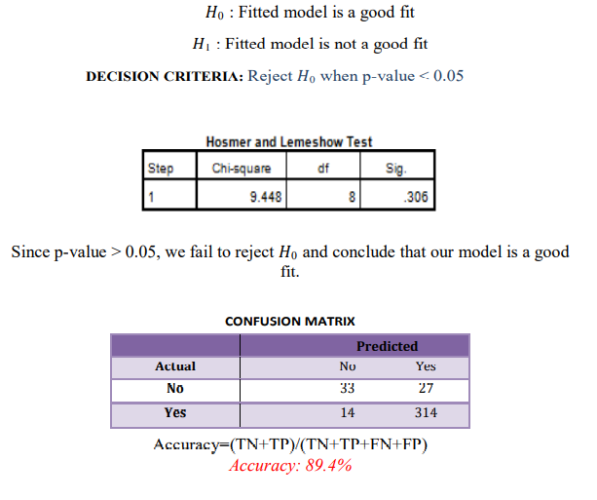
HOMSER & LEMESHOW (TEST FOR GOODNESS OF FIT)

Slide 20
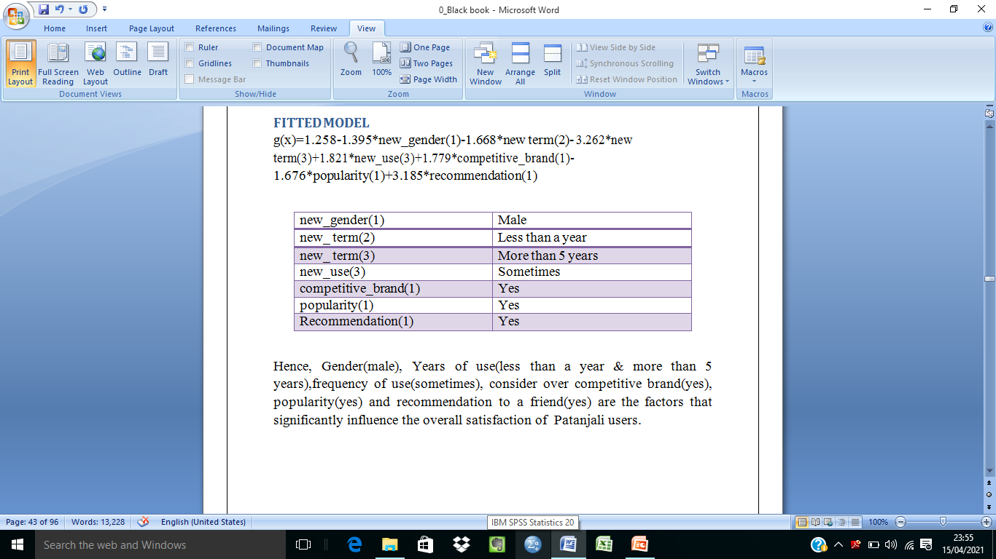
FITTED MODEL

Slide 21
ARTIFICIAL NEURAL NETWORK & K-NEAREST NEIGHBORS
OBJECTIVE 4
To predict if the Non-Patanjali users will be overall satisfied after using Patanjali products.
An artificial neural network (ANN) is the component of artificial intelligence that is meant to simulate the functioning of a human brain.
The k-nearest neighbors (KNN) algorithm is a simple, supervised machine learning algorithm that can be used to solve both classification and regression problems.
Here, two techniques (KNN & ANN) are used to build our model & check the accuracy score. The model with the best accuracy score is used for further analysis to predict the overall satisfaction of non- Patanjali users.

Slide 22
Target Variable
Independent Variables
Gender
Causes for better brand
Overall Satisfaction
Location
Other herbal brands
Reasons for buying
Benefits
Improvements needed
Total Sample Size=388
No. of observations in training data
=0.80*388
=310
No. of observations in testing data
=0.20*388
=78

Slide 23
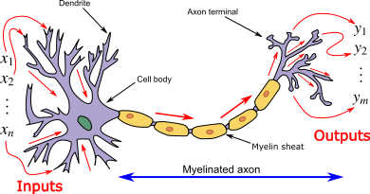
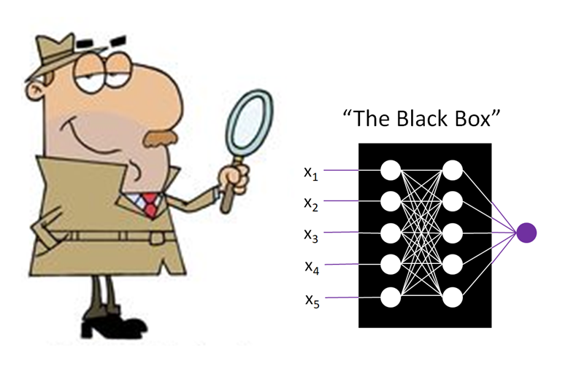
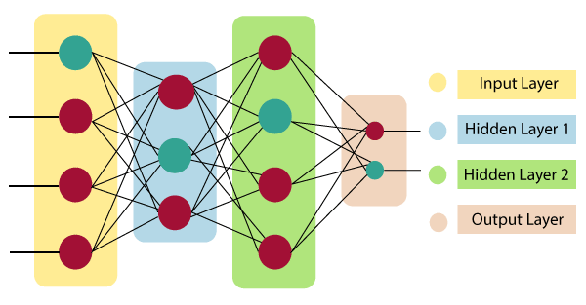
ARTIFICIAL NEURAL NETWORK

Slide 24
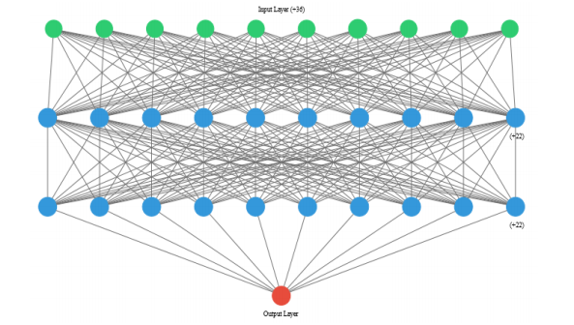
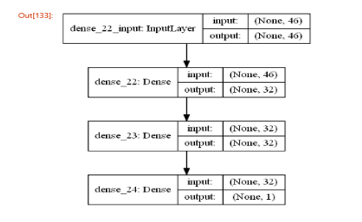

Slide 25
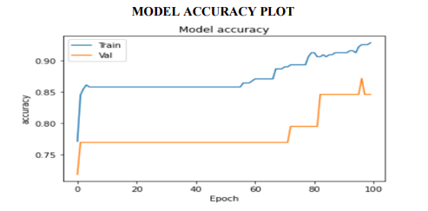
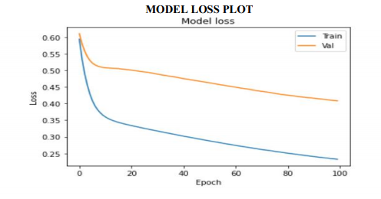
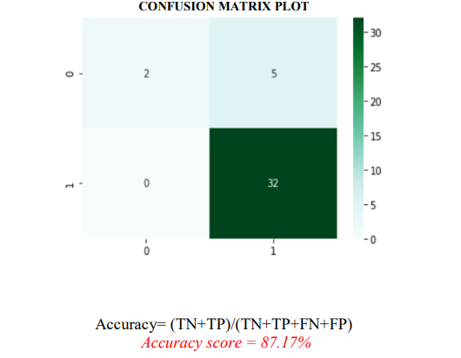
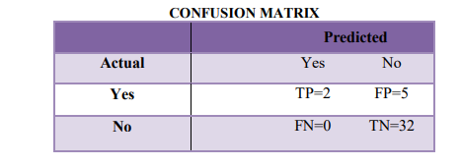

Slide 26
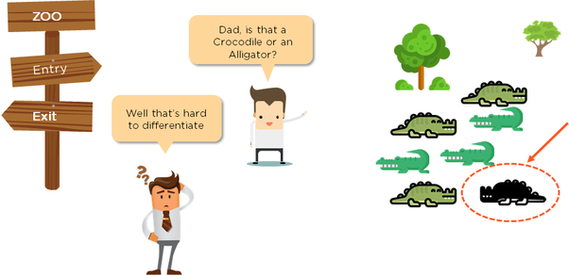
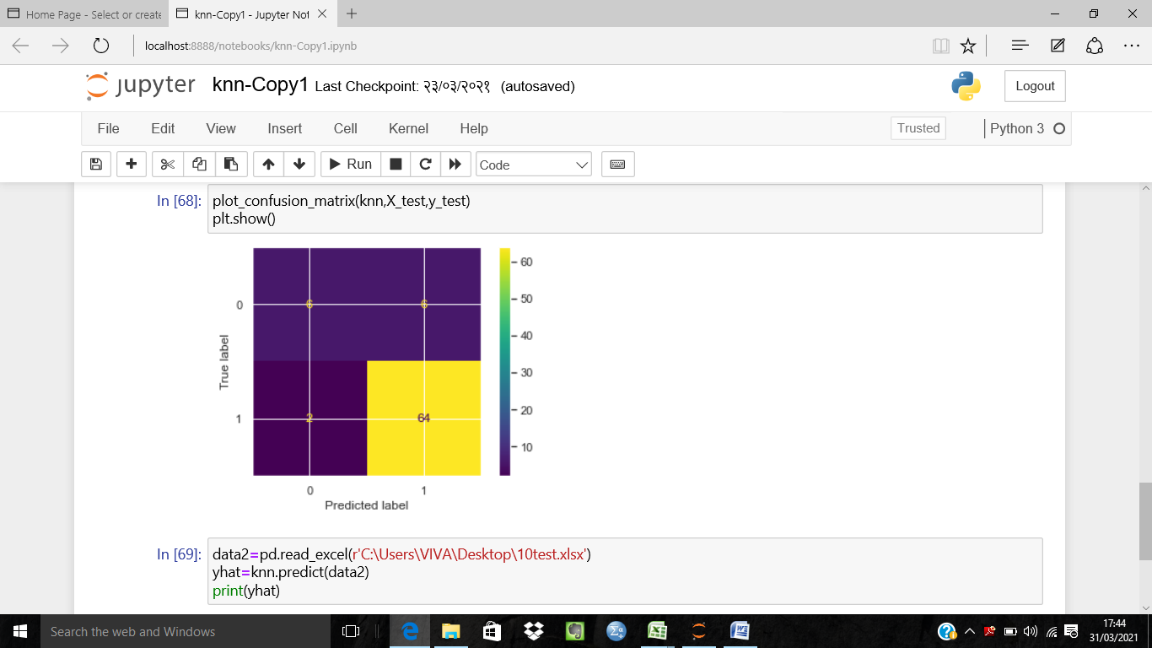
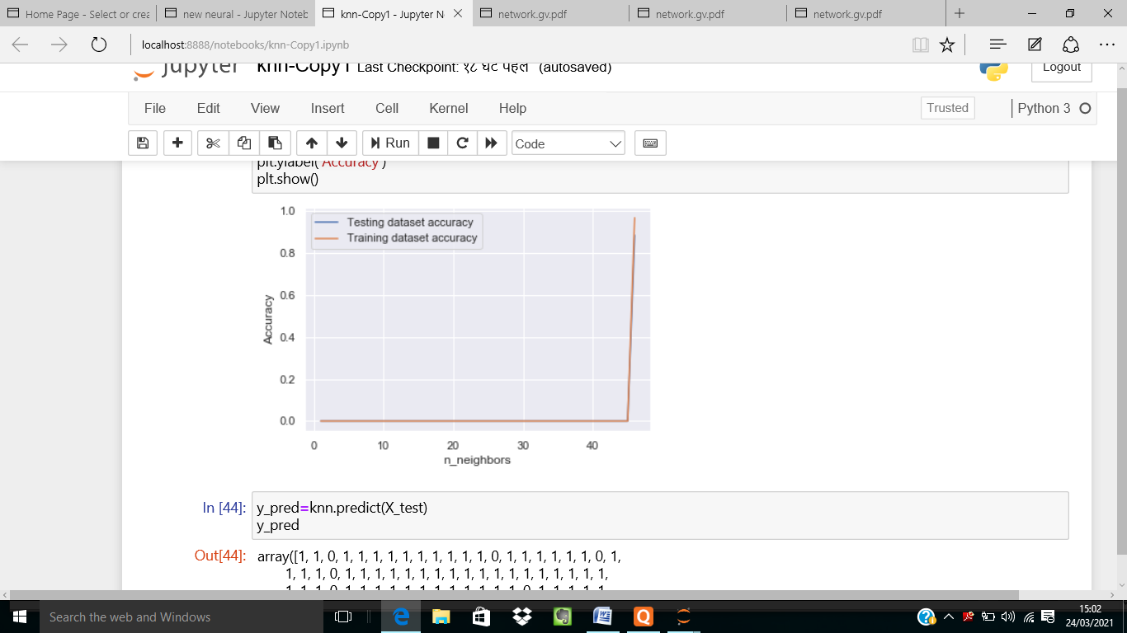
K-NEAREST NEIGHBORS
 | Predicted
Actual |  | Yes | No
Yes |  | TP=6 | FP=6
No |  | FN=2 | TN=64
Accuracy= (TN+TP)/(TN+TP+FN+FP)
Accuracy score = 89.74%

Slide 27
PREDICTIONS USING K-NN
44 Customers
44 Customers
Yes(1)
0 Customers
No(0)

Slide 28
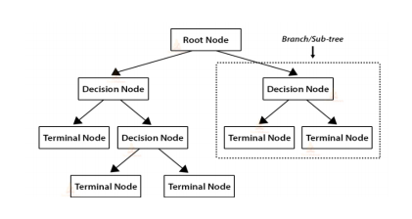
DECISION TREES
OBJECTIVE 5
To predict how often Customer use Patanjali products based on Socio-Demographic factor, Sources of Awareness and their Buying and Spending Patterns.
Decision tree analysis is a powerful decision-making tool which initiates a structured nonparametric approach for problem-solving.
TERMINOLOGIES
Root Node
Decision Node
Terminal Node
Branch
Splitting
Pruning

Slide 29
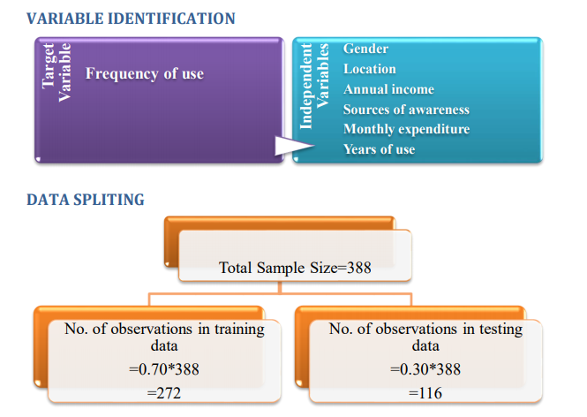

Slide 30
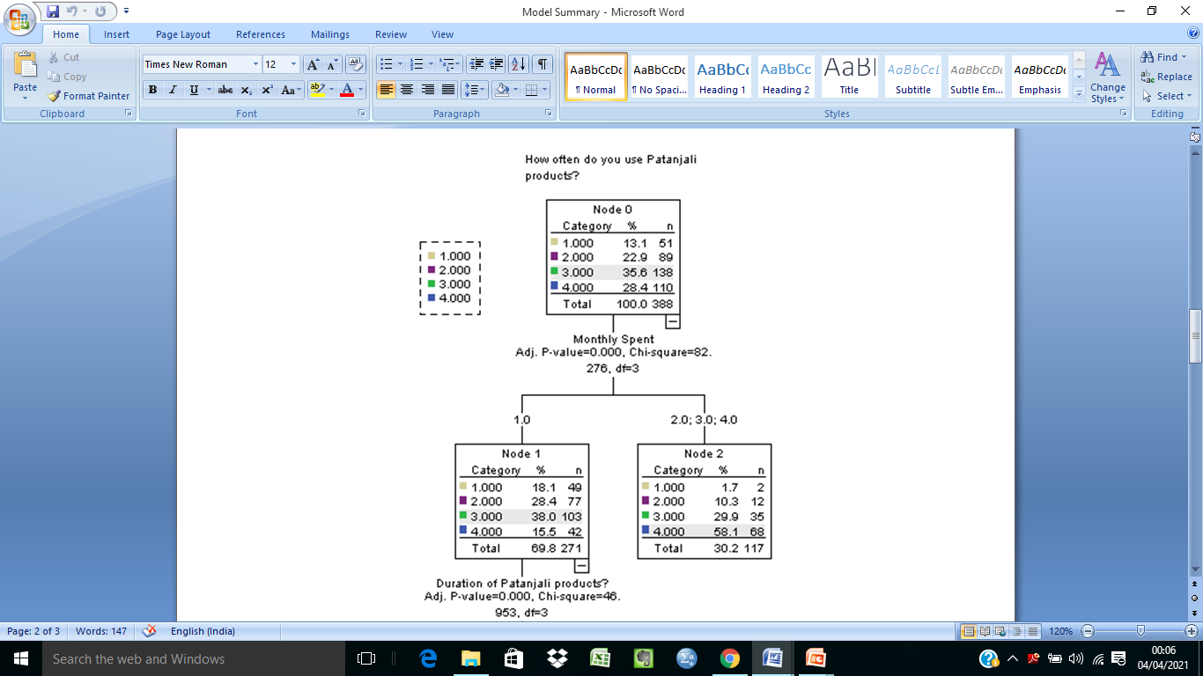
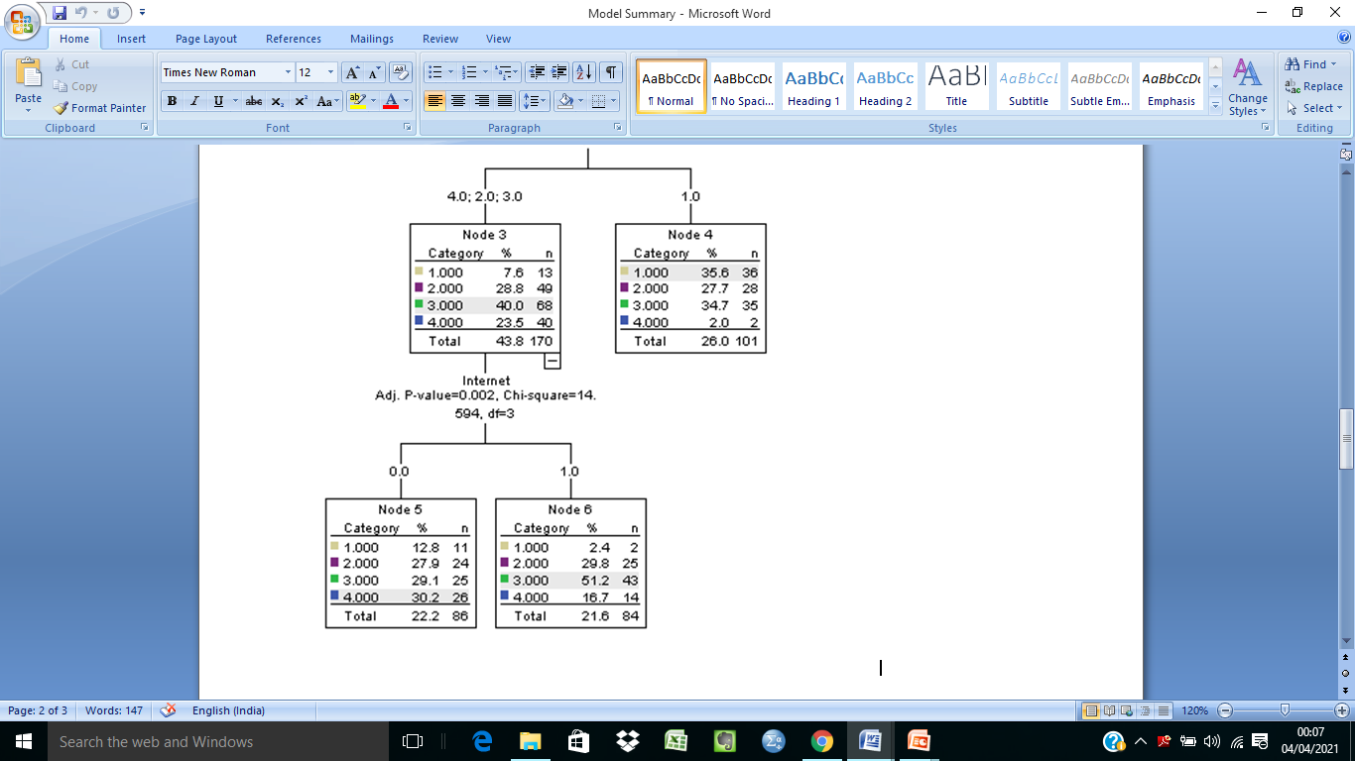

Slide 31
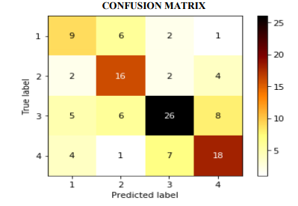
Training set predictions
43 customers
Only on trial basis
65 Customers
Rarely
82 Customers
81 Customers
Sometimes
Regularly
Testing set predictions
20 customers
Only on trial basis
29 Customers
Rarely
37 Customers
31 Customers
Sometimes
Regularly
Sometimes
Regularly
Rarely
Only on trial basis
Accuracy score = 58.97%

Slide 32
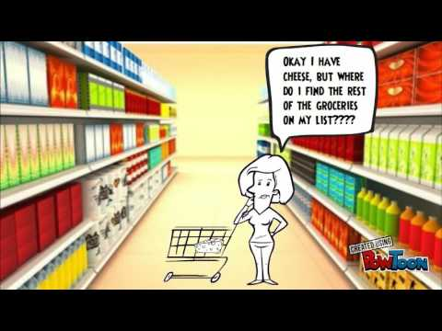
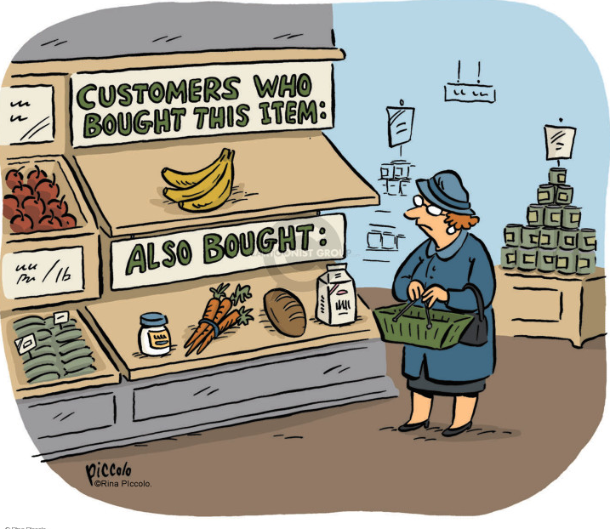
MARKET BASKET ANALYSIS USING APRIORI ALGORITHM
OBJECTIVE 6
To identify next product purchase that might interest a customer.
The process of discovering frequent item sets in large transactional database is called Market Basket Analysis.

Slide 33
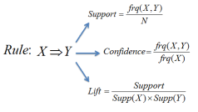
APRIORI ALGORITHM
Systematically identify item set’s that occur frequently in the data set with a support greater than a pre-specified threshold.
Calculate the confidence of all possible rules given the frequent item set’s and keep only those with a confidence greater than a pre-specified threshold.
Association Rule: X→Y
X: Rule antecedent
Y: Rule consequent
Association rule analysis is a technique to uncover how items are associated to each other. There are three common ways to measure association.
Support: This says how popular an item set is, it is number of times an item appears in total number of transaction in other word we say frequency of item.
Confidence: This says how likely item Y is purchased when item X is purchased, expressed as {X -> Y}.
Lift: It is ratio of expected confidence to observed confidence. it is described as confidence of Y when item X was already known(x/y) to the confidence of Y when X item is unknown.

Slide 34
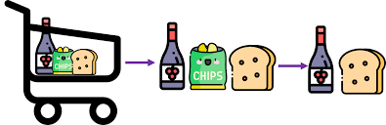
Steps
Determine the support of item sets in the transactional database, and select the minimum support and confidence.
Find all the rules of these subsets that have higher confidence value than the threshold or minimum confidence.
Sort the rules as decreasing order of lift.
Take all supports in the transaction with higher support value than the minimum or selected support value.

Slide 35
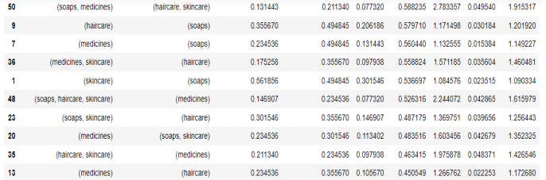
Products
Skin care
Soaps
Medicine
Haircare
Dental care
Spices
Dairy
Bakery
Food & Beverage
Others

Slide 36
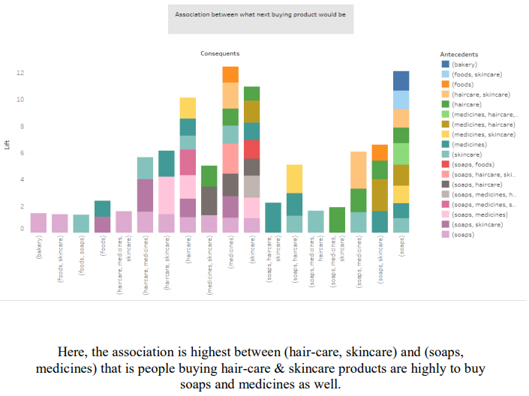

Slide 37
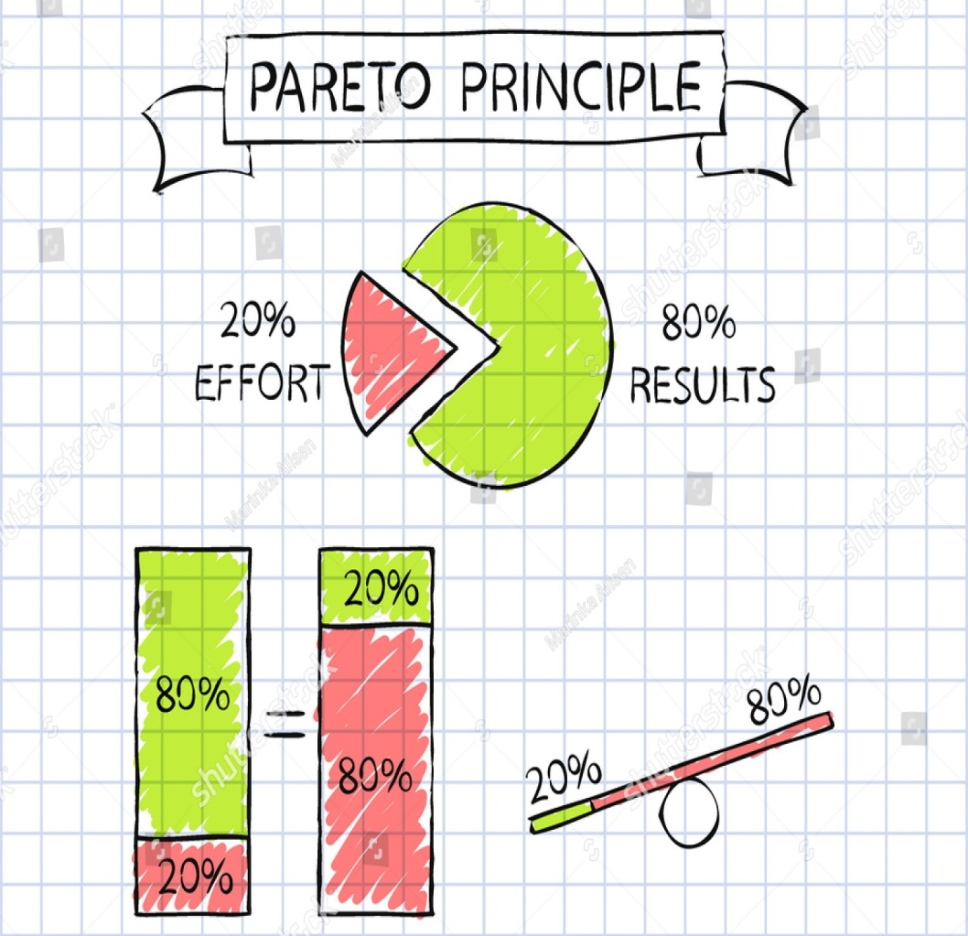
PARETO ANALYSIS
OBJECTIVE 7
To study the factors that affects Patanjali from being a better brand.
Pareto Analysis is a statistical technique in decision-making.
It uses the Pareto Principle (also known as the 80/20 rule) the idea that by doing 20% of the work you can generate 80% of the benefit of doing the entire job.
A Pareto chart is a basic quality tool that helps you identify the most frequent defects, complaints, or any other factor you can count and categorize.

Slide 38
To identify factor that affects preferences of people while buying Patanjali products.
Variables | Frequency | Cumulative %
Health-wise | 239 | 0.302532
Quality-wise | 208 | 0.565823
Price wise | 183 | 0.797468
Brand wise | 68 | 0.883544
Quantity wise | 67 | 0.968354
Demand wise | 25 | 1
Health-wise, Quality-wise & Price-wise are the major factors that affects the preferences of people while buying Patanjali products.

Slide 39
2.To identify reasons for not buying Patanjali Products.
Reasons for buying Patanjali products | Frequency | Cumulative %
Reasonable Price | 224 | 0.21374
Good Quality | 223 | 0.426527
Health Benefits | 203 | 0.620229
Indian Brand | 175 | 0.787214
Availability | 89 | 0.872137
Brand Image | 48 | 0.917939
Advertisments | 44 | 0.959924
Wide Range of Varieties | 42 | 1
Lack of availability, lack of brand image, lack of advertisements& lack of wide ranges of varieties are the reasons for not buying the Patanjali product.

Slide 40
3. To identify in which category Patanjali needs improvement so as to be a better brand.
Categories for improvement | Frequency | Cumulative %
Online Services | 145 | 0.20195
Ayurvedic Standards | 144 | 0.402507
Customer Satisfaction | 124 | 0.575209
Marketing Strategy | 122 | 0.745125
Availability | 85 | 0.86351
Quality | 71 | 0.962396
Annual Sales | 27 | 1
So as to improvise as a brand, Patanjali needs to improve the online services, ayurvedic standards, customer satisfaction and Marketing strategy.

Slide 41
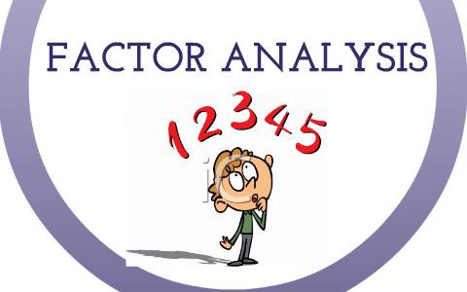
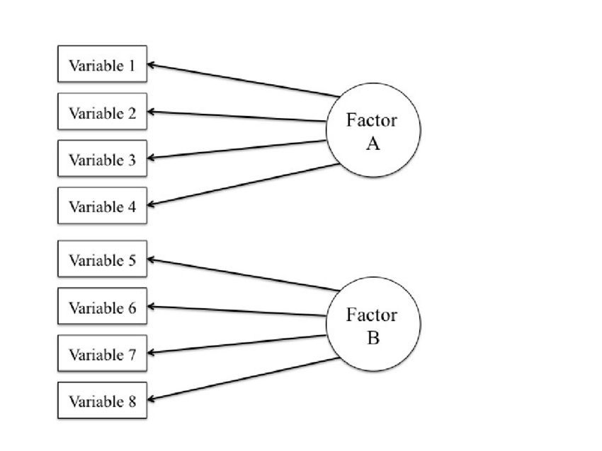
FACTOR ANALYSIS
OBJECTIVE 8
To determine the factors that influences the people for buying Patanjali products.
Factor analysis is a statistical method used to describe variability among observed, correlated variables in terms of a potentially lower number of unobserved variables called factors.

Slide 42
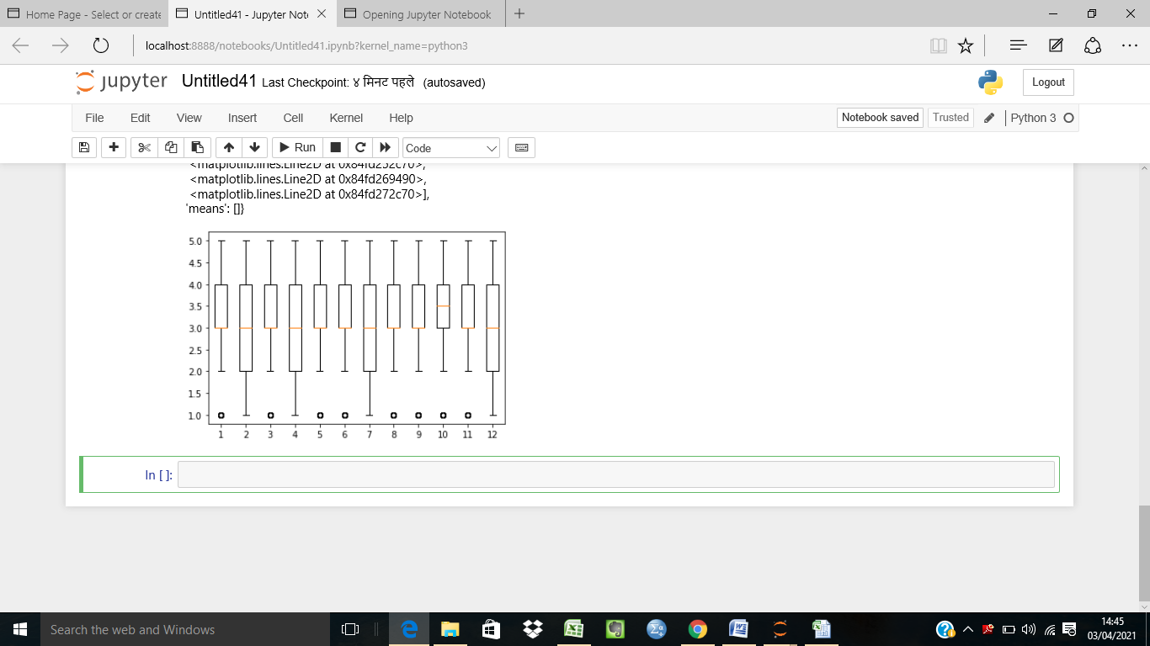
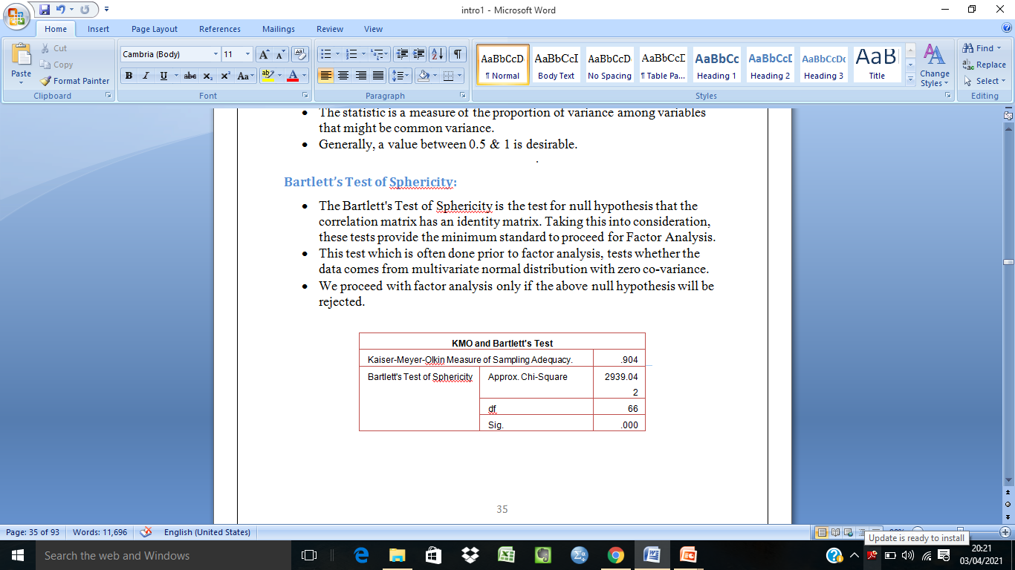
ASSUMPTIONS CHECKING
Variables considered
V1: Popularity
V2: Advertisements
V3: Quality
V4: Availability
V5: Purity
V6: Organic
V7: Appealing to youngsters
V8: Increase the promotion
V9: Brand Ambassadors
V10: Low price
V11: Beneficial
V12: Customer service
OUTLIERS
MULTICOLLINEARITY
KMO Criterion: 0.904>0.5
Bartlett’s Test of Sphericity:p-value(0.000) < 0.05
No outliers present

Slide 43
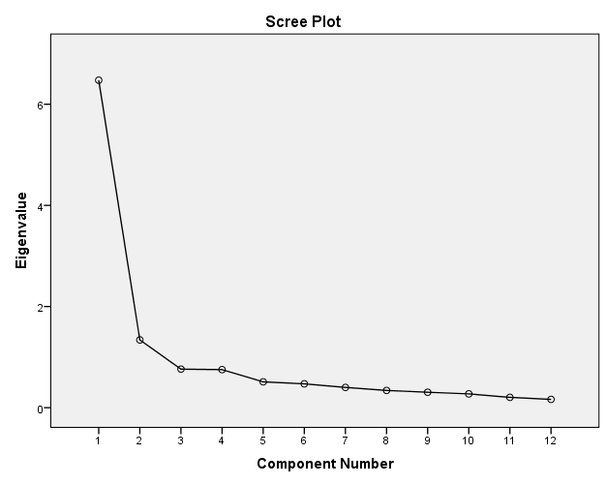
Rotated Component Matrixª
 | Component
 | 1 | 2
Popularity | .768 | .259
Advertisements | .736 | .143
Quality | .797 | .211
Availability | .725 | .258
Purity | .815 | .252
Organic | .821 | .327
Appealing to Youngsters | .747 | .132
Increase the promotion | .615 | .423
Brand ambassadors | .525 | .433
Low Price | .080 | .853
Beneficial | .322 | .819
Customer Service | .315 | .783
The point where the slope of the curve is clearly leveling off (the “elbow) indicates the number of factors that should be generated by the analysis which is after the 2th component.

Slide 44
Varimax Method
Consumer's Preferences
Popularity
Advertisements
Consumer's Needs
Low Price
Beneficial
Quality
Availability
Purity
Organic
Appealing to youngsters
Increased the promotion
Customer Service
Brand ambassador
 | R1 | R2
V1 | 0.768
V2 | 0.736
V3 | 0.797
V4 | 0.725
V5 | 0.815
V6 | 0.821
V7 | 0.747
V8 | 0.615
V9 | 0.525
V10 |  | 0.853
V11 |  | 0.819
V12 |  | 0.783

Slide 45

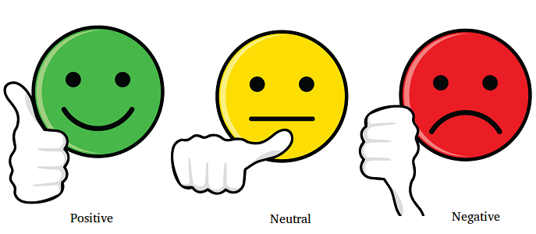
SENTIMENTAL ANALYSIS
OBJECTIVE 9
To analyze the sentimental behaviour of the customers towards the brand Patanjali.
Sentiment analysis (or opinion mining) is a natural language processing technique used to determine whether data is positive, negative or neutral.

Slide 46
5 MOST FREQUENT WORDS
 | Word | Freq
satisfied | Satisfy | 32
good | good | 19
brand | brand | 9
quality | quality | 9
never | never | 8

Slide 47
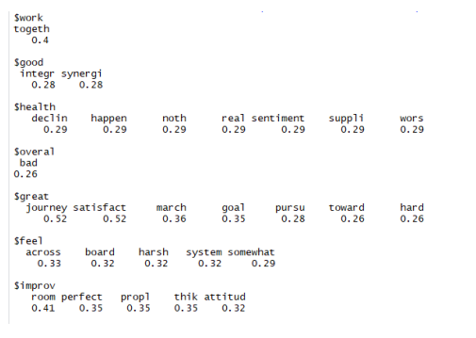
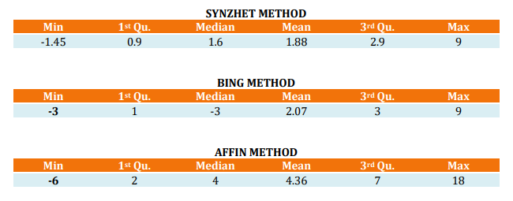
WORD ASSOCIATION SENTIMENT SCORES
SYUZHET METHOD

Slide 48
EMOTION CLASSIFICATION
Reviews | Anger | Anticipation | Disgust | Fear | Joy | Sadness | Surprise | Trust | Negative | Positive
1 | 0 | 1 | 0 | 0 | 1 | 0 | 0 | 2 | 1 | 2
2 | 0 | 3 | 0 | 1 | 0 | 0 | 0 | 1 | 1 | 5
3 | 0 | 1 | 0 | 0 | 1 | 1 | 0 | 0 | 0 | 4
4 | 0 | 3 | 0 | 0 | 2 | 0 | 1 | 1 | 2 | 2
5 | 0 | 2 | 0 | 0 | 2 | 0 | 0 | 3 | 1 | 3
6 | 0 | 0 | 0 | 0 | 0 | 0 | 0 | 4 | 0 | 1
7 | 0 | 2 | 0 | 0 | 2 | 0 | 0 | 4 | 0 | 6
8 | 0 | 4 | 0 | 0 | 4 | 0 | 0 | 4 | 1 | 5
9 | 0 | 3 | 0 | 0 | 3 | 0 | 0 | 3 | 0 | 5
10 | 1 | 1 | 0 | 1 | 0 | 0 | 0 | 1 | 0 | 3

Slide 49
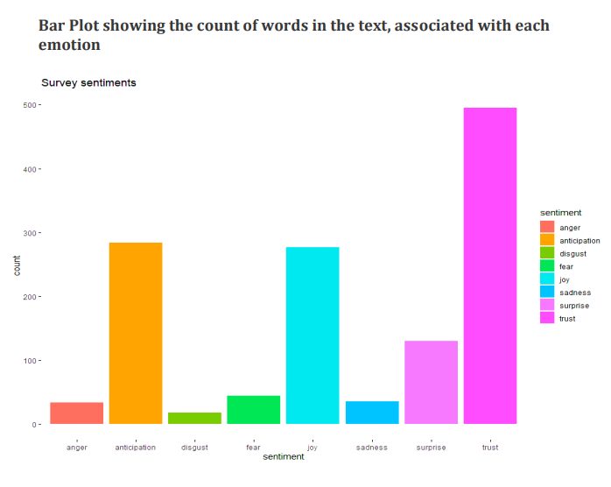

Slide 50
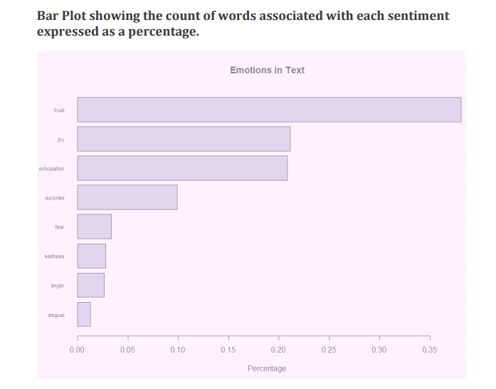

Slide 51
Conclusions
SWOT ANALYSIS
Patanjali Ayurveda Ltd have a strong impact on popularity due to the reputation of Baba Ramdev, patriotism, low prices of products & purity.
The company needs to improve in the fields of manufacturing units, over dependency on Baba Ramdev, no longer penetration pricing, product dependence & lack of experienced graduates.
The company have great opportunities in growth of organic sector, can be expanded in rural markets, it can be expanded globally, huge tie-ups and to be diversified.
Price war, increasing competition, negative word- of mouth & poor reap can affect the company’s growth & reputation.
CHI-SQUARE TEST OF INDEPENDENCE
Patanjali product users(male or female) have no association with the health consciousness.
That is, there is no association between gender & doctor’s recommendation while buying the products.
Also, there is no association between gender & side effects while using the Patanjali products.
FACTOR ANALYSIS
Consumer’s Preferences: Popularity, Purity, Brand ambassadors, Quality, Organic, Increased promotion, Appealing to youngsters, Advertisements, Availability
Consumer’s Needs: Low price, Beneficial, Customer Service
SENTIMENTAL ANALYSIS
The analysis shows that Patanjali users have a very high emotion of “Trust” on their products & a very low emotion of “Disgust” for the products.
Hence, this is a good sign of team health.

Slide 52
LOGISTIC REGRESSION
Patanjali have the highest influence on years of use(less than a year & more than 5 years), frequency of use(sometimes), consideration over other brands, popularity & recommendation to their friends for the overall satisfaction of their customers.
MARKET BASKET ANALYSIS USING APRIORI ALGORITHM
The customers would prefer buying soaps & medicines after buying haircare & skincare products on their next purchase, as this technique shows the maximum association between these products.
ARTIFICIAL NEURAL NETWORS & K-NEAREST NEIGHBORS
These techniques were conducted to predict if non-Patanjali users will be overall satisfied after using the Patanjali products.
After checking the accuracy for both the techniques, K-NN having the highest accuracy, we conclude that all the non-Patanjali users will be overall satisfied after using the Patanjali products.
PARETO ANALYSIS
Health-wise, Quality-wise & Price-wise are the major factors that affects the preferences of people while buying the products.
Lack of availability, lack of brand image, lack of advertisements & lack of wide range of varieties are the reasons for not buying the Patanjali products.
So as to improvise as a brand, Patanjali needs to improve the online services, Ayurvedic standards, customer satisfaction and Marketing strategy.
DECISION TREES
After making predictions for training & testing sets, majority of the people will use Patanjali products sometimes, followed by people using them regularly and rarely.
Less number of people will use them only on trial basis.

Slide 53
References
http://www.analyticsvidhya.com/
https://stackoverflow.com/
https://www.patanjaliayurved.net/
https://bstrategyhub.com/patanjali-swot-analysis-2019-swot-analysis-of-patanjali/
https://github.com/
https://libguides.library.kent.edu/spss/chisquare#:~:text=The%20Chi%2DSquare%20Test%20of%20Independence%20determines%20whether%20there%20is,Chi%2DSquare%20Test%20of%20Association.
https://www.kdnuggets.com/2015/05/top-10-data-mining-algorithms-explained.html
https://pythonprogramminglanguage.com/top-data-mining-algorithms/
https://www.geeksforgeeks.org/machine-learning/

Slide 54
Thank You

